Slide 1
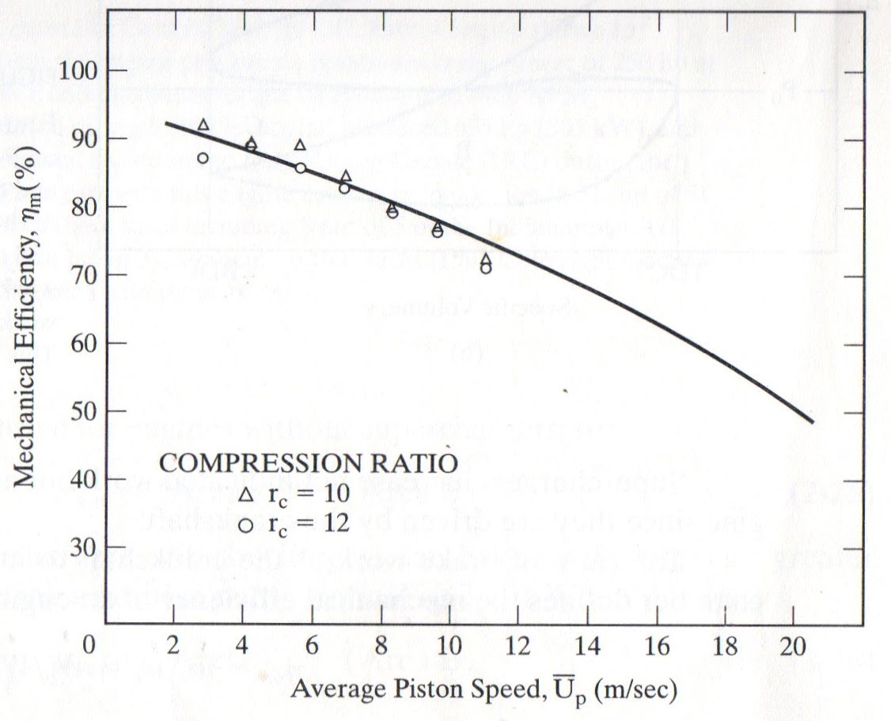

Slide 2
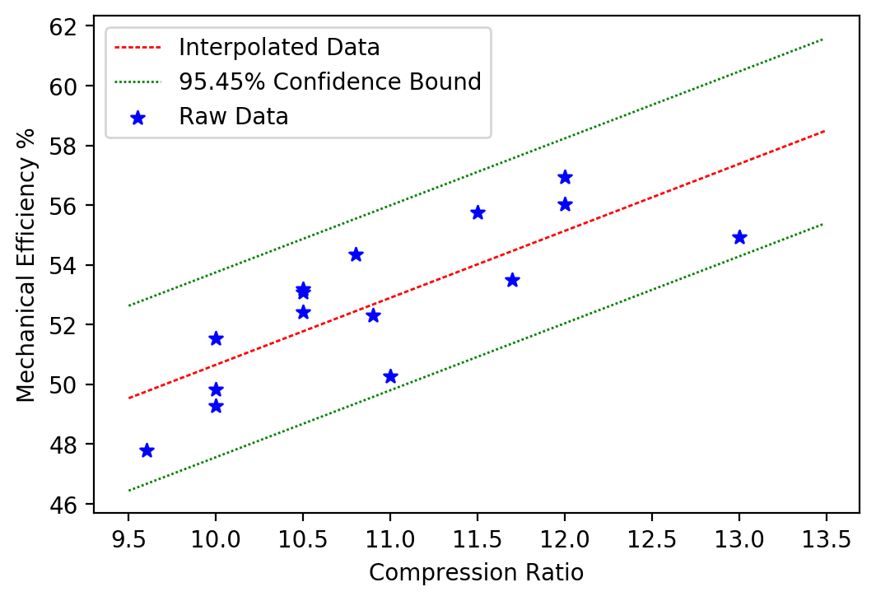

$$ME=2.24∗CR+28.24±3.095$$

